Slide 1
Automobile Prices Regression
Lab 2

Slide 2
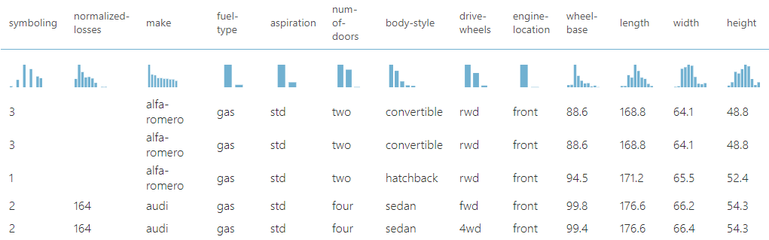
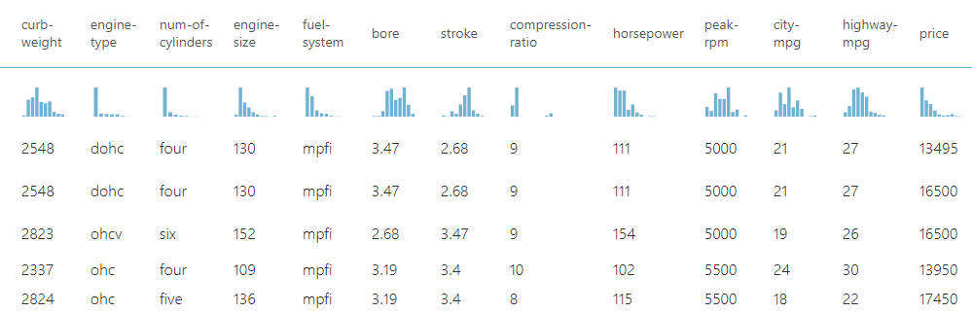
Dataset Description
Prices of various automobiles against make, model and technical specifications
205 observations and 26 columns
Missing values in the data
symboling: rating corresponds to the degree to which the auto is more risky than its price indicates. Cars are initially assigned a risk factor
normalized-losses: relative average loss payment per insured vehicle year. This value is normalized for all autos within a particular size classification (two-door small, station wagons, sports/speciality, etc…), and represents the average loss per car per year.

Slide 3
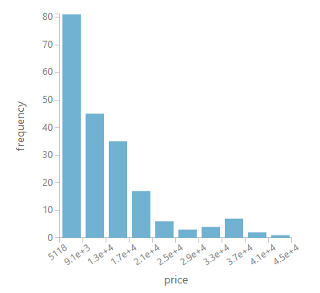
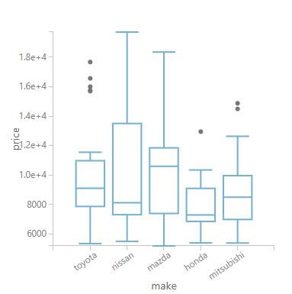
Price distribution of cars is positively skewed; Presence of outlier prices.

Slide 4
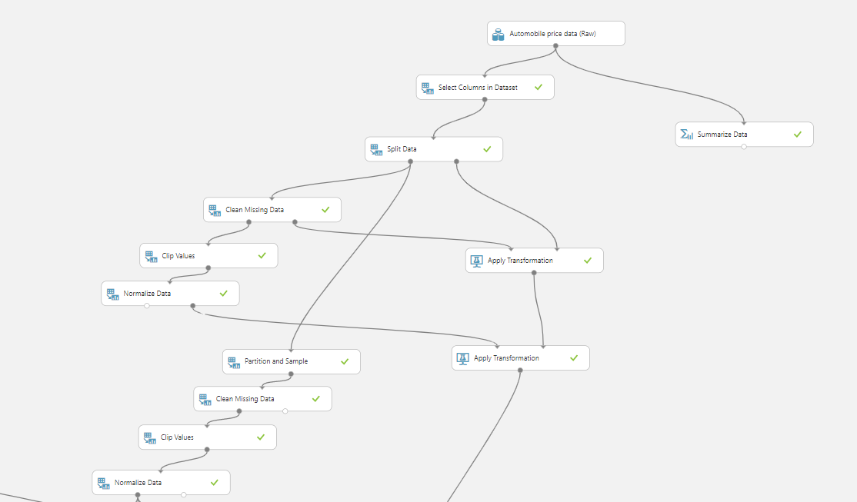
Data Preprocessing
Data was split 80:20;
Based on later permutation importances, less important features were removed
MICE used to impute missing data
Outlier data removed when model is being trained (testing data not clipped)
Numerical features were standardized

Slide 5
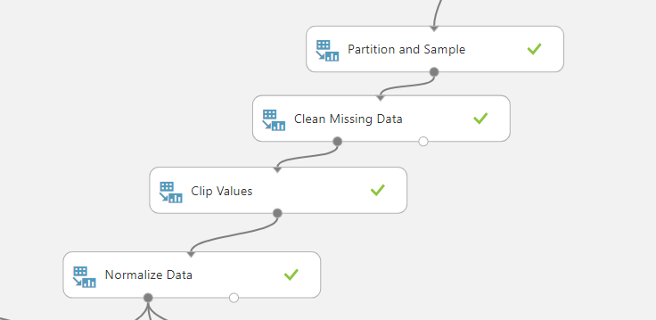
Data Preprocessing
5-Fold CV was performed on the training split to allow for cross-validated hyperparameter tuning
For each split in k-fold CV, data transforms are fitted to that split’s training fold. This prevents data leakage during k-fold CV.
For inference, data transformers are refitted to the entire training split.

Slide 6
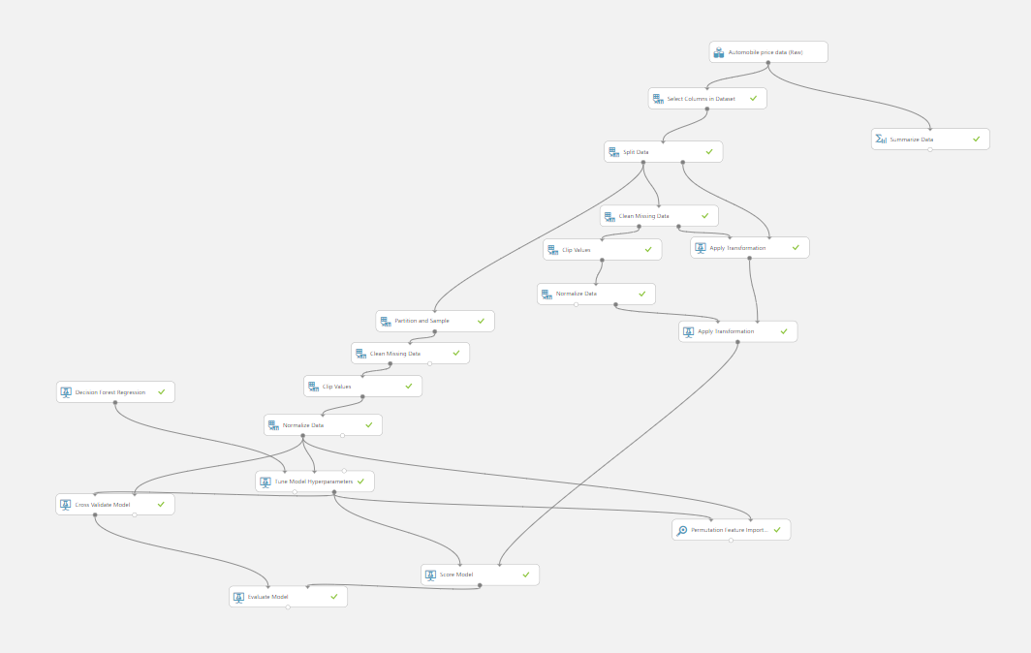
Overall Workflow

Slide 7
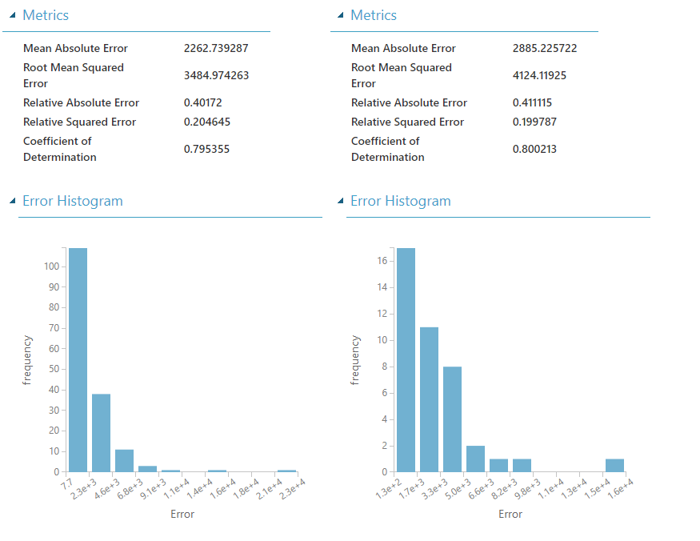
Model: Linear Regression
Average RMSE of 3484.97 on CV folds, and RMSE of 4124.12 on the hold out set.
This indicates the model may not generalize well to new data.
Residuals do not appear to be normally distributed. OLS Regression assumes that the residuals are normally distributed.

Slide 8
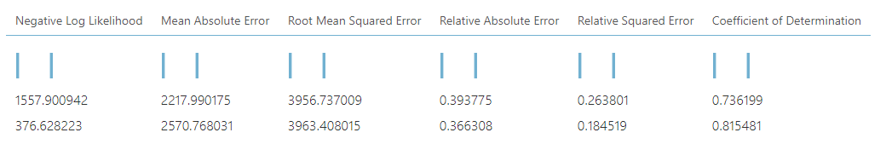
Model: Decision Forest
Initial: Average RMSE of 3956.74 on CV folds, RMSE of 3963.41 on the hold out set.
After hyperparameter tuning, RMSE decreased to 3864.77 on CV and 3543.18 on hold out set.

Slide 9
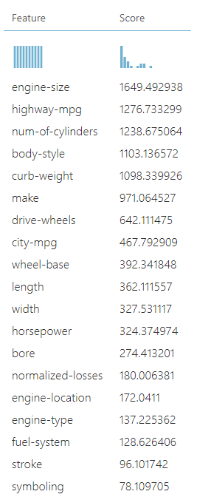
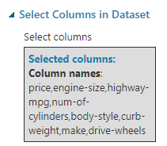
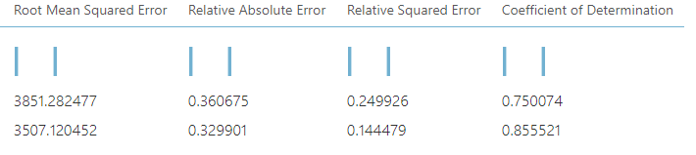
Feature Selection
Permutation importance was used to generate feature importances
Model Used: Decision Forest
Top 7 scoring features were kept, resulting in a improvement in the RMSE

Slide 10
References
ML Studio (classic): Partition and Sample - Azure | Microsoft Docs
ML Studio (classic): Permutation Feature Importance - Azure | Microsoft Docs
ML Studio (classic): Cross-Validate Model - Azure | Microsoft Docs

